Slide 1



U-Pb Geochronometry and (U-Th)/He Thermochronometry of the Windmill Islands, East Antarctica
Patrick Boyd
Peter Reiners, Ph.D. & Stuart Thomson, Ph.D.
Department of Geosciences, University of Arizona

Slide 2
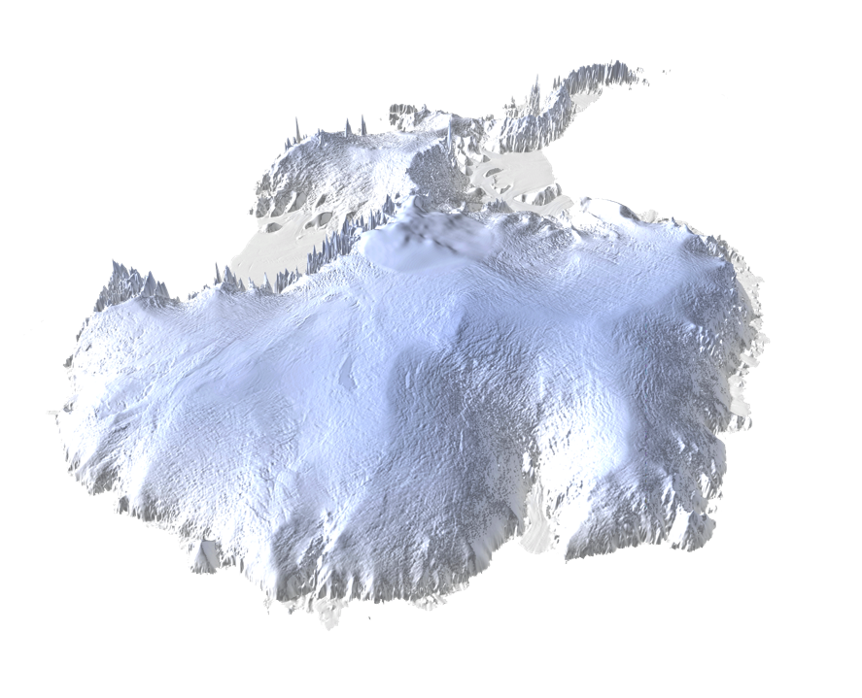
The Windmill Islands

Slide 3
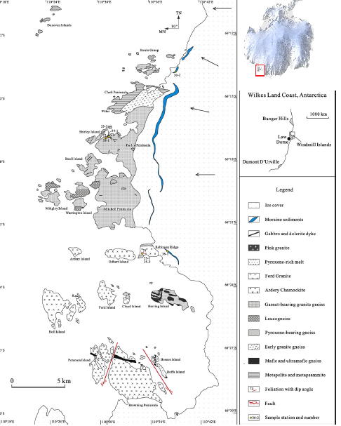

Slide 4
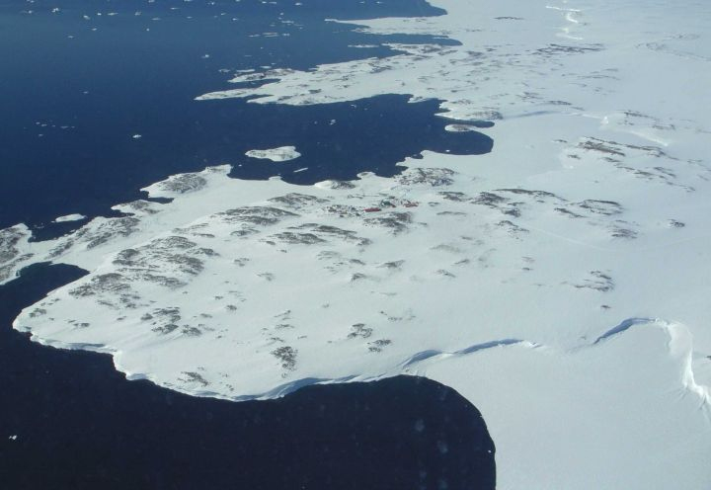
Windmill Islands, Wilkes Land, Antarctica

Slide 5
What do we want to know?
Timing of metamorphic and magmatic events?
Timing of low temperature heating and cooling?
Can supercontinent formation/breakup be seen in U-Pb or (U-Th)/He ages?
Can Eocene glaciation be seen in (U-Th)/He ages?

Slide 6
Process
Mineral separation on 8 different samples
17 apatite (U-Th)/He ages (From 4 samples)
19 zircon (U-Th)/He ages (From 4 samples)
5 zircon U-Pb ages

Slide 7
Methods
Apatite + Zircon (U-Th)/He (Low temperature history, often shows timing of erosion)
-Apatite closure temperature is 60-80° C
-Zircon closure temperature is 160-180° C
Zircon U-Pb (Crystallization and metamorphism timing)
-900-1000° C closure temperature

Slide 8
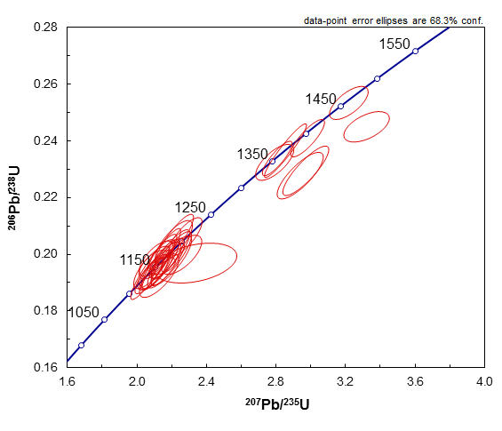
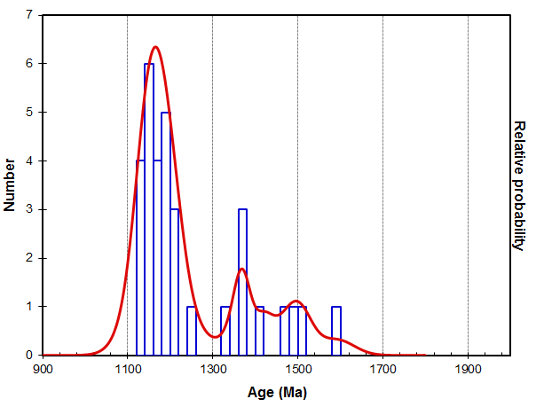
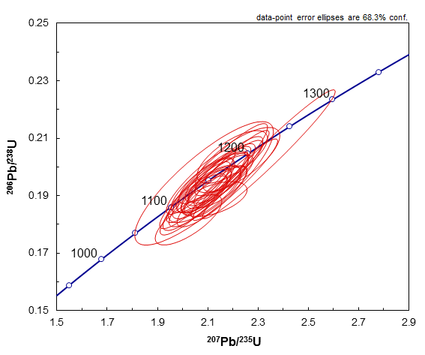
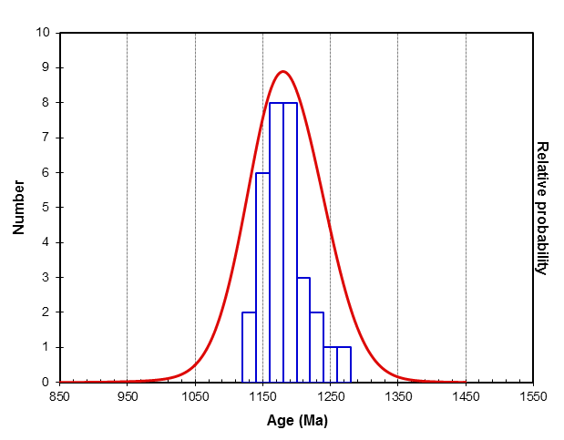
U-Pb Results
1.167 Billion Years
1.18 Billion Years

Slide 9
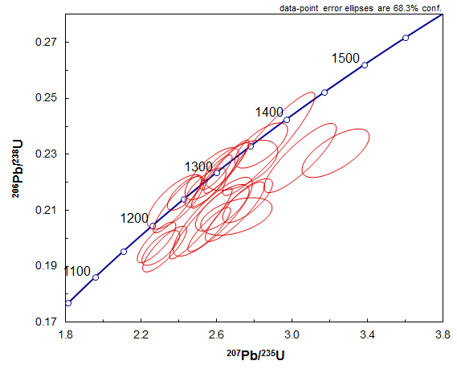
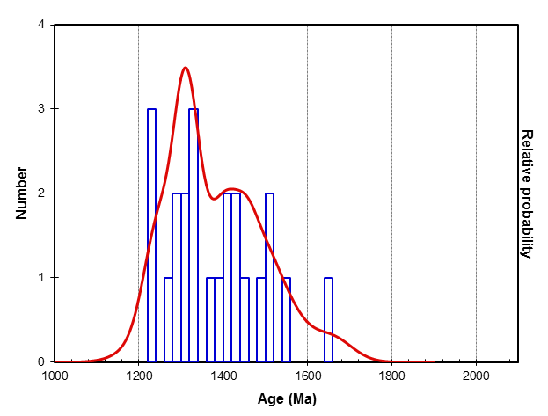
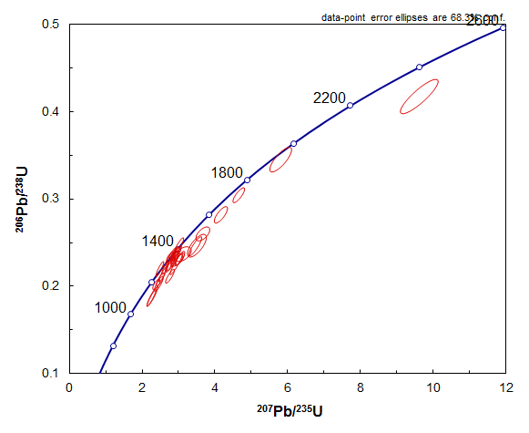
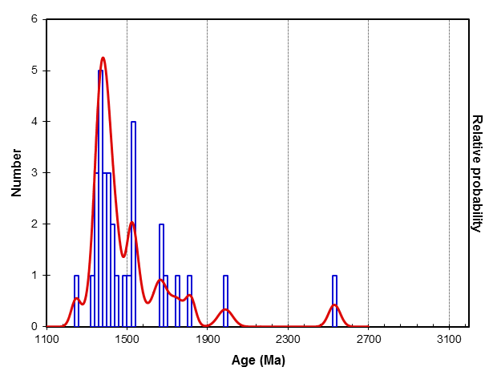
U-Pb Results
1.308 Billion Years
1.379 Billion Years

Slide 10
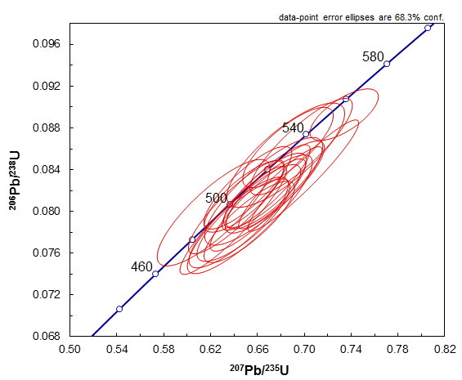
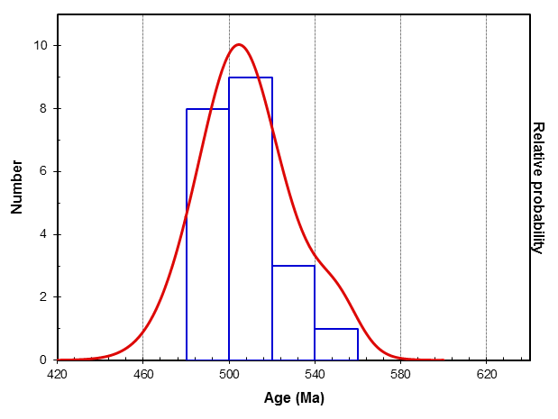
U-Pb Results
504 Million Years

Slide 11
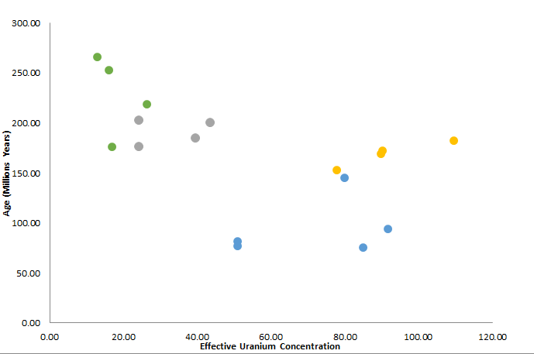
(U-Th)/He Apatite Results

Slide 12
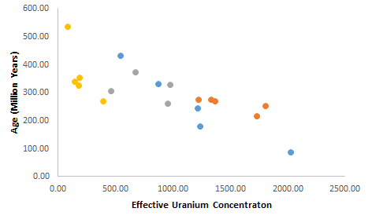
(U-Th)/He Zircon Results

Slide 13
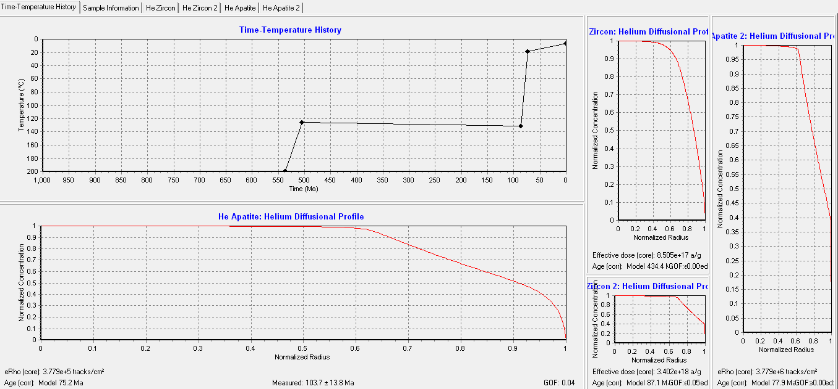
(U-Th)/He Thermal Modeling of Zircon and Apatite from sample PRR_27946, Holl Island

Slide 14
Conclusions
Grenville aged metamorphism
500 Ma Pan-African magmatism
300 Ma Permian cooling similar to ages acquired in SW Australia
75 Ma slight heating event
No trace of Eocene glacial erosion
Varying thermal histories based on sample location

Slide 15
Acknowledgements
Dr. Peter Reiners
Dr. Stuart Thomson
Arizona Space Grant Consortium
Arizona Radiogenic Helium Dating Laboratory
Arizona Laserchron Center

